Slide 1

EXPLORATORY DATA ANALYSIS
Loan Risk EDA: Project Goals & Business Objectives
This analysis examines 614 loan applications to transform underwriting from reactive manual review into proactive, data-driven risk modeling. Three interconnected goals guide this investigation.

Slide 2




STRATEGIC FRAMEWORK
Three Core Analytical Goals
Establish a Data-Driven Diagnostic Framework
Assess Data Integrity & Distribution Anomalies
Identify the Ultimate Drivers of Credit Risk
Move from manual, reactive underwriting to proactive risk modeling by understanding how applicant attributes interact to influence loan outcomes.
Inspect the 614 training applications for missing variables, extreme wealth outliers, and severe demographic imbalances before running downstream algorithms.
Mathematically isolate which factors — such as raw income versus past repayment compliance — are statistically correlated with credit approval.

Slide 3
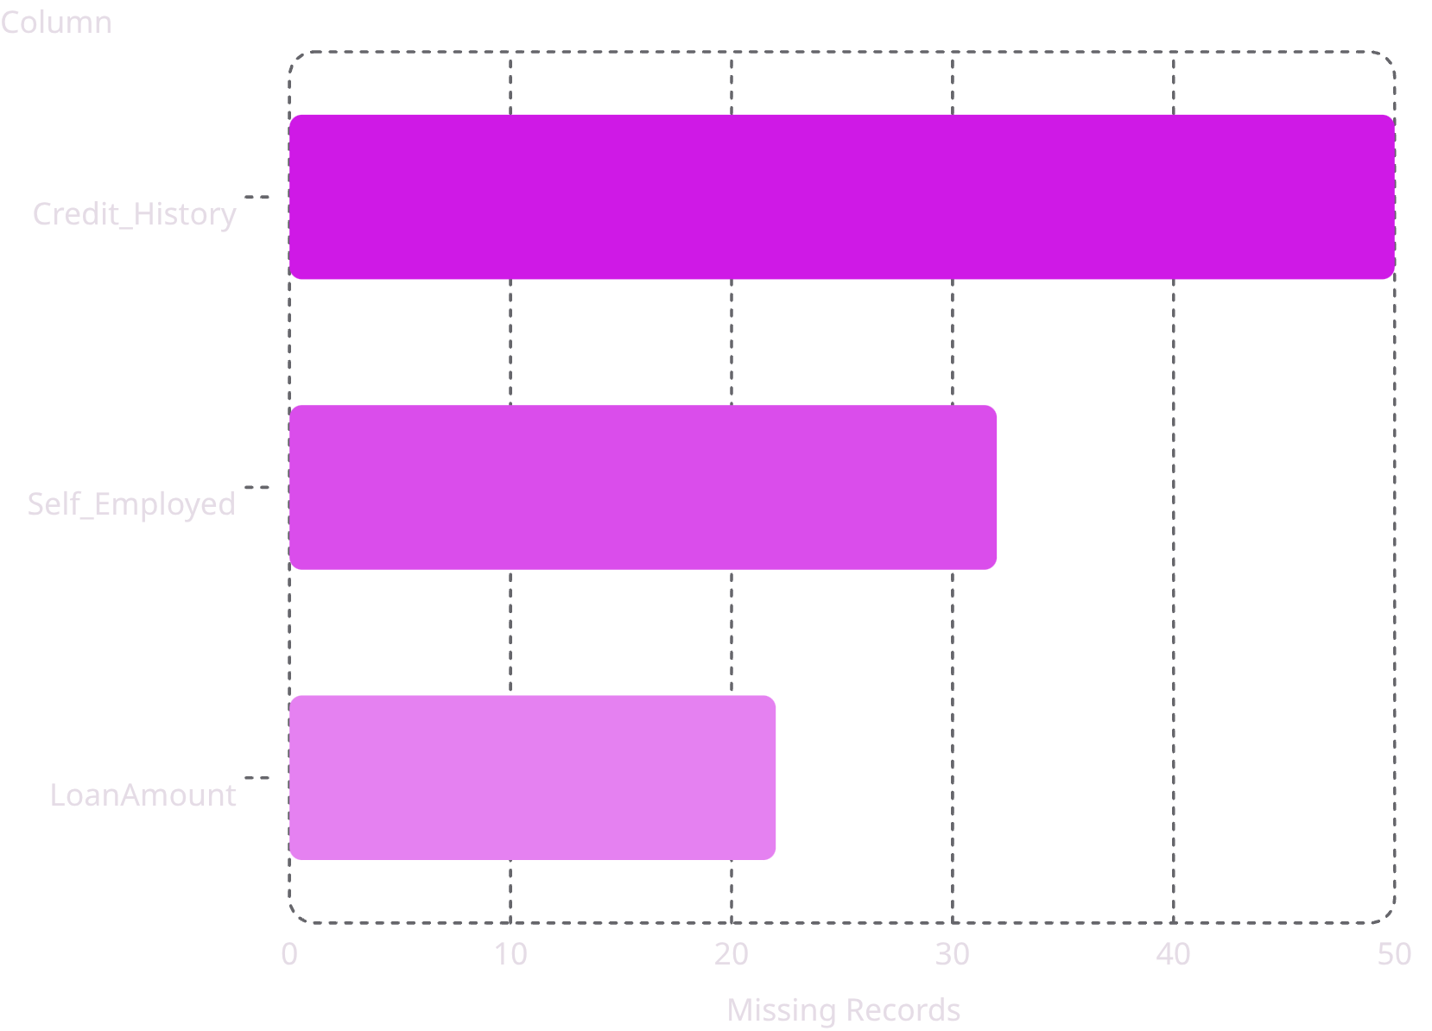
DATA PROFILING
Data Profiling & Structural Integrity
Initial Footprint
Missing Values by Column
The training dataset contains exactly 614 records across 13 columns. Zero duplicate rows were found, confirming the structural integrity of all application records.
Missing Data Warning
Several columns require treatment before modeling. Missing records are concentrated in Credit_History (50 missing), Self_Employed (32 missing), and LoanAmount (22 missing).
Median imputation is recommended for numerical fields; mode imputation for categorical variables. This prevents data loss and downstream bias.

Slide 4



DATA PREPARATION
Cleaning & Preparing Loan Data for Analysis
Before diving into predictive modeling, a critical step involves refining the raw data. This process addresses structural imperfections to ensure the reliability and fairness of our insights.
Addressing Missing Values
Managing Outliers
Acknowledging Imbalances
Identified 50 missing Credit_History records, 32 for Self_Employed, and 22 for LoanAmount. Imputation (median for numerical, mode for categorical) was applied to prevent data loss and bias.
Extreme income outliers were flagged and treated to avoid skewing statistical analyses and model training, ensuring the model reflects typical applicant behavior.
A severe gender imbalance (81% male) was noted. While not directly 'cleaned,' this insight informs careful model development to prevent unintended bias and promote fair lending practices.
These preparation steps are vital for building robust and equitable loan risk models, directly contributing to fair lending decisions and improved model reliability.

Slide 5

STATISTICAL ANALYSIS
Continuous Metrics: The Skewness Distortion
Summary Statistics
Why This Matters
Metric
Mean
Median
Skewness
The gap between mean ($5,403) and median ($3,812) proves that a small number of ultra-wealthy applicants pull the average artificially high. Because the mean is deeply distorted by these outliers, the median is the only reliable baseline for credit limits.
For all downstream modeling, a logarithmic transformation (log(x+1)) must be applied to balance the distribution and prevent skewed financial metrics from corrupting risk scores.
ApplicantIncome
$5,403
$3,812
6.54
LoanAmount
$146.4k
$128.0k
2.68
Both variables fail the Shapiro-Wilk normality test (p < 0.05).

Slide 6
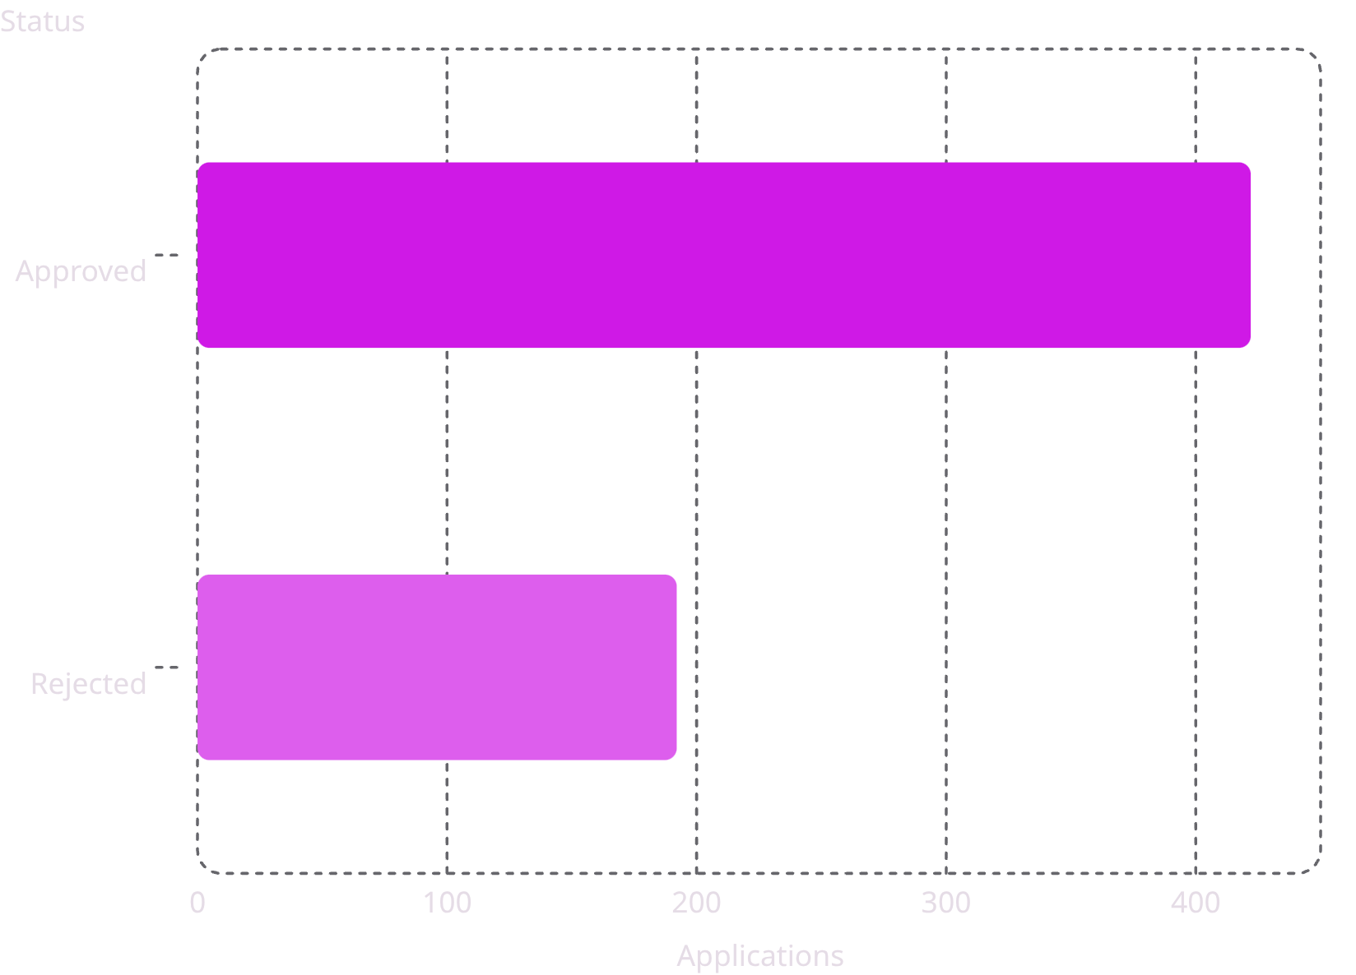
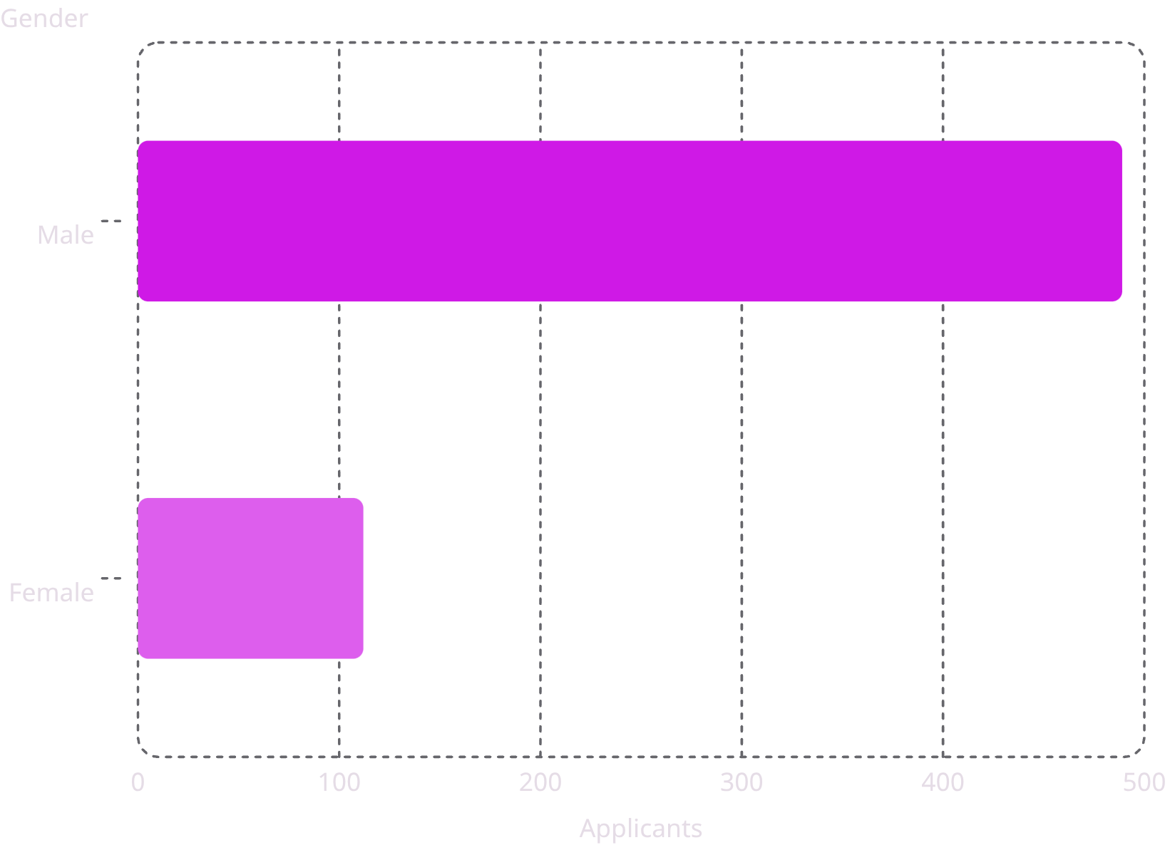
DEMOGRAPHICS
Baseline Distribution & Target Landscape
Loan Approval Baseline
Gender Distribution
68.7% approved vs. 31.3% rejected. Predictive models will easily default to "Approved" unless penalizing criteria are strictly enforced.
81.4% Male vs. 18.6% Female. This severe skew suggests historically male-dominated outreach. Risk managers must audit models to ensure this imbalance does not translate into systemic lending bias.

Slide 7
CORRELATION ANALYSIS
Justified Variable Interdependence
Standard Pearson correlation would produce incorrect results on this dataset. Pearson expects perfectly normal, bell-curved data — using it on skewed metrics like ApplicantIncome would let outliers completely warp our understanding of what drives loan decisions.
Tested Relationship
Scales Involved
Chosen Coefficient
Justification & Business Meaning
ApplicantIncome vs. LoanAmount
Ratio vs. Ratio
Spearman Rank
Used because both variables are heavily non-normal. Identifies that requested loans scale monotonically with income.
Credit_History vs. Loan_Status
Binary vs. Binary
Cramér's V
Best for two nominal categories. Quantifies how directly a past default guarantees an immediate rejection.
Education vs. Loan_Status
Ordinal vs. Binary
Spearman / Cramér's V
Tests if holding a college degree provides a statistically significant advantage in securing a loan.

Slide 8
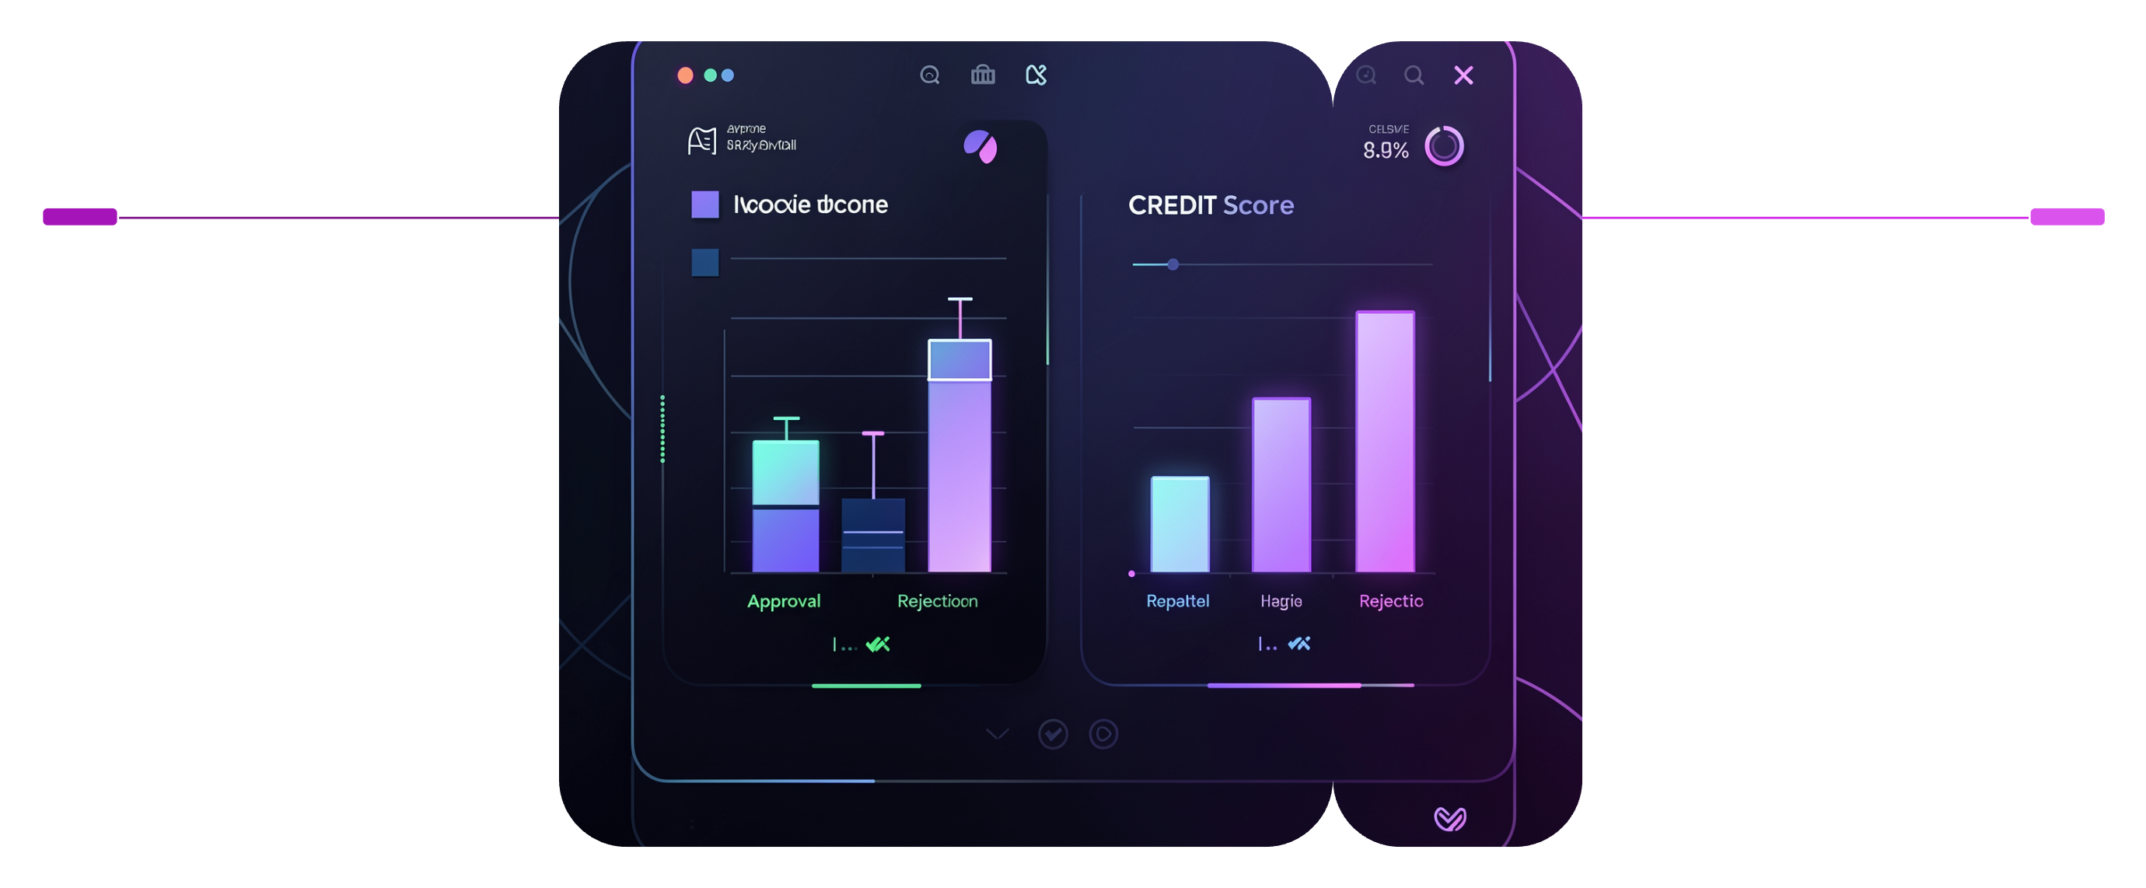
VISUAL EVIDENCE
Visual Proof: Income vs. Past Compliance
Two visualizations reveal the true hierarchy of credit risk drivers — and challenge the assumption that income alone determines approval.
Log-Transformed Income by Loan Status
Credit History vs. Loan Status (Normalized)
The median log-income for approved ('Y') and rejected ('N') applicants is virtually identical. High income does not protect an applicant from rejection if they carry an active history of default. Income is a secondary factor, not a deciding one.
The normalized stacked bar chart reveals an extreme divergence. Applicants with a credit history score of 1.0 have a massive approval rate, while those with a 0.0 score are almost completely rejected. Credit history is the dominant signal.
Income Comparison
Credit History Impact
Median income nearly identical for approved and rejected applicants
Score 1.0 → near-certain approval; 0.0 → near-certain rejection
Together, these visuals confirm that past repayment compliance overwhelmingly outweighs raw financial capacity in loan approval decisions.

Slide 9
KEY FINDINGS
What the Data Actually Tells Us
Credit History is King
Income is a Noise Variable
Past repayment compliance is the single most powerful driver of approval. Demographics and income are secondary signals — a finding that should directly reshape underwriting policy.
Raw income is hyper-skewed by outliers and shows near-identical medians across approved and rejected groups. Without log-transformation, it distorts rather than informs risk scores.
Demographic Imbalance is a Risk
Approval Baseline is Deceptive
Over 80% of historical applications belong to a single demographic. Models trained on this data risk encoding systemic bias unless fairness constraints are explicitly enforced.
A 68.7% approval rate creates a naive baseline that inflates model accuracy. Class weighting or stratified sampling is required to build a genuinely predictive classifier.

Slide 10

ACTION PLAN
Business Summary & Action Plan
1
Automate Credit History Triage
2
Standardize Income Review
Credit history is the most important factor in approval decisions. Use it as the first screening step so strong applications move forward quickly and staff can focus time where it matters most.
Create a consistent way to review income across all applications. This helps staff make clearer decisions, reduces the impact of unusual cases, and improves fairness in the review process.
3
Address Demographic Slices
Make the process fairer by broadening outreach and reviewing policies that may limit who applies. A more balanced applicant pool supports better market reach and more equitable decisions.

Slide 11

NEXT STEPS
From EDA to Production: The Path Forward
Organize & Prepare Data
Build Decision Rules
Make sure records are complete, accurate, and ready for use.
Create clear, consistent criteria for evaluating applications.
Identify Key Decision Factors
Launch & Review
Focus on the information that matters most for approval decisions.
Put the process into practice and check regularly for fairness.
This four-phase roadmap turns insights into an operating process — from preparing records to launching a fair review system — so each finding leads to a practical improvement in underwriting decisions.
Immediate Priorities
Strategic Watch Items
Make sure key application fields are complete
Review income and loan amounts for unusual values
Set up a simple first-pass review for applications with strong credit history
Check decision outcomes regularly to make sure they stay fair
Increase outreach to groups that have been underrepresented
Revisit approval guidelines as the process is put into practice

